Slide 1


CODERS IN RIO SUMMIT 2019
Fabrício Veronez
A Anatomia de um Deploy no Kubernetes

Slide 2






PATROCINADORES & APOIADORES

Slide 3
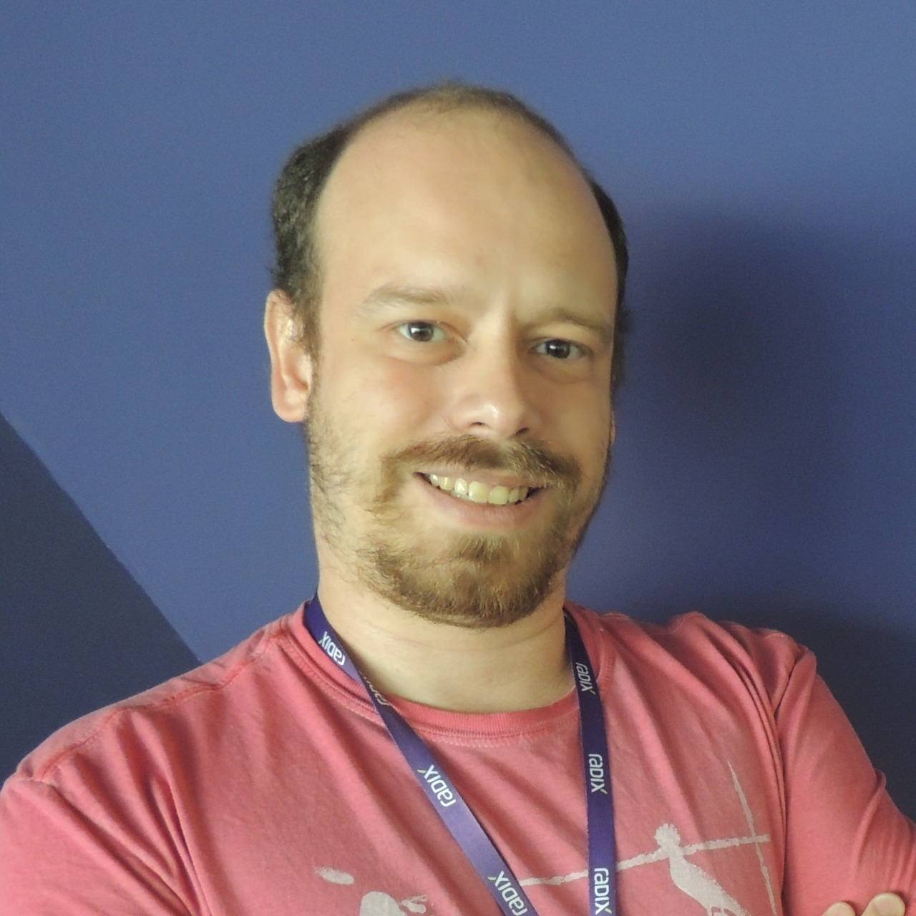


Fabrício Veronez
Arquiteto de Software
http://veronez.dev
Email - fabricioveronez@gmail.com
Linkedin - http://www.linkedin.com/in/fabricioveronez
Telegram - fabricioveronez

Slide 4


Slide 5
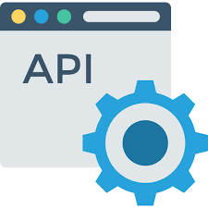

Proposta

Slide 6
Objetos em um deploy Kubernetes
Pod
Services
Labels
Selectors
Deployment
ReplicaSet

Slide 7

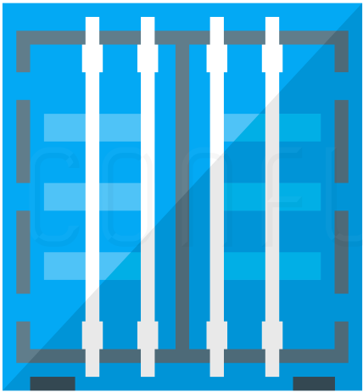
Pod
10.10.10.3

Slide 8
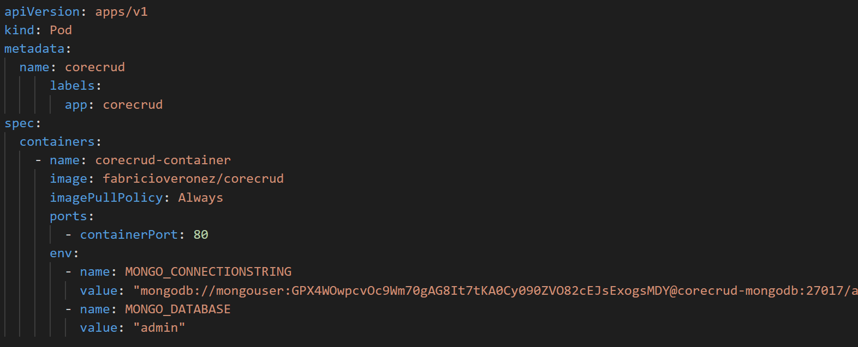

Slide 9
Pod
10.10.10.3
WebApi
MongoDB

Slide 10
10.10.10.3
10.10.10.6
Service
WebApi
MongoDB

Slide 11
Services
ClusterIP
NodePort
LoadBalancer
ExternalName

Slide 12
ClusterIP
Cluster Kubernetes
Pod A
Service
Pod B
Pod B
Pod B

Slide 13
NodePort
Cluster Kubernetes
Pod A
Service Port: 3000
Pod A
Pod A

Slide 14
Load Balancer
Load Balancer
Cluster Kubernetes
Service
Pod A
Pod A
Pod A

Slide 15
External Name
Cluster Kubernetes
External Service
Pod A
Service

Slide 16
Labels e Selectors
Selector App=MongoDB
10.10.10.3
10.10.10.6
Label App=MongoDB
Service
WebApi
MongoDB

Slide 17
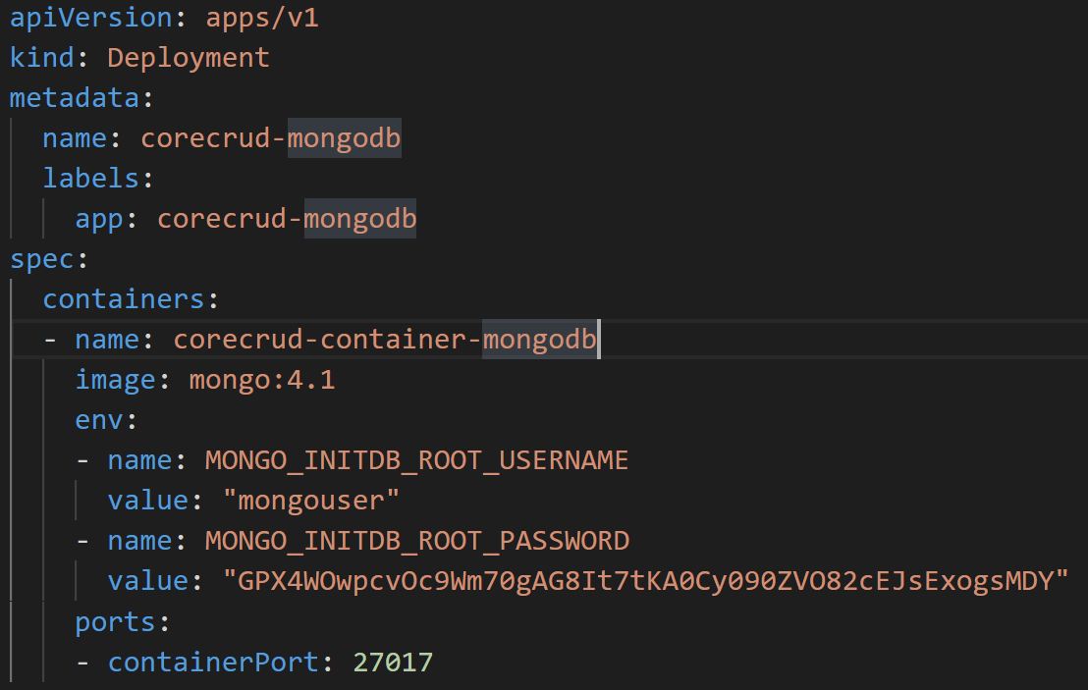

Slide 18
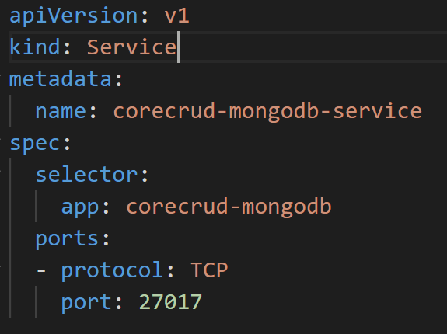

Slide 19
Deployment
Deployment
Cluster Kubernetes
ReplicaSet A
Pod A
Pod A
Pod A

Slide 20
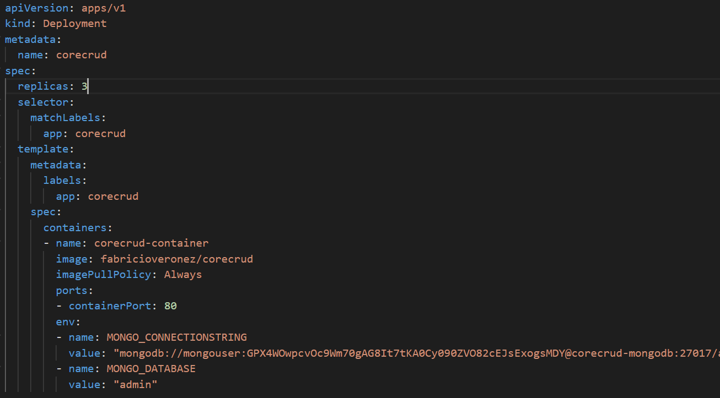

Slide 21
10.10.10.5
Label App=corecrud
10.10.10.4
10.10.10.7
Label App=MongoDB
Label App=corecrud
Service
Service
Selector App=MongoDB
Selector App=corecrud
10.10.10.3
Label App=corecrud

Slide 22
DEMO

Slide 23

Quer saber mais?
http://bit.ly/news-veronezdev

Slide 24

DÚVIDAS

Slide 25

CODERS IN RIO SUMMIT 2019

